Slide 1

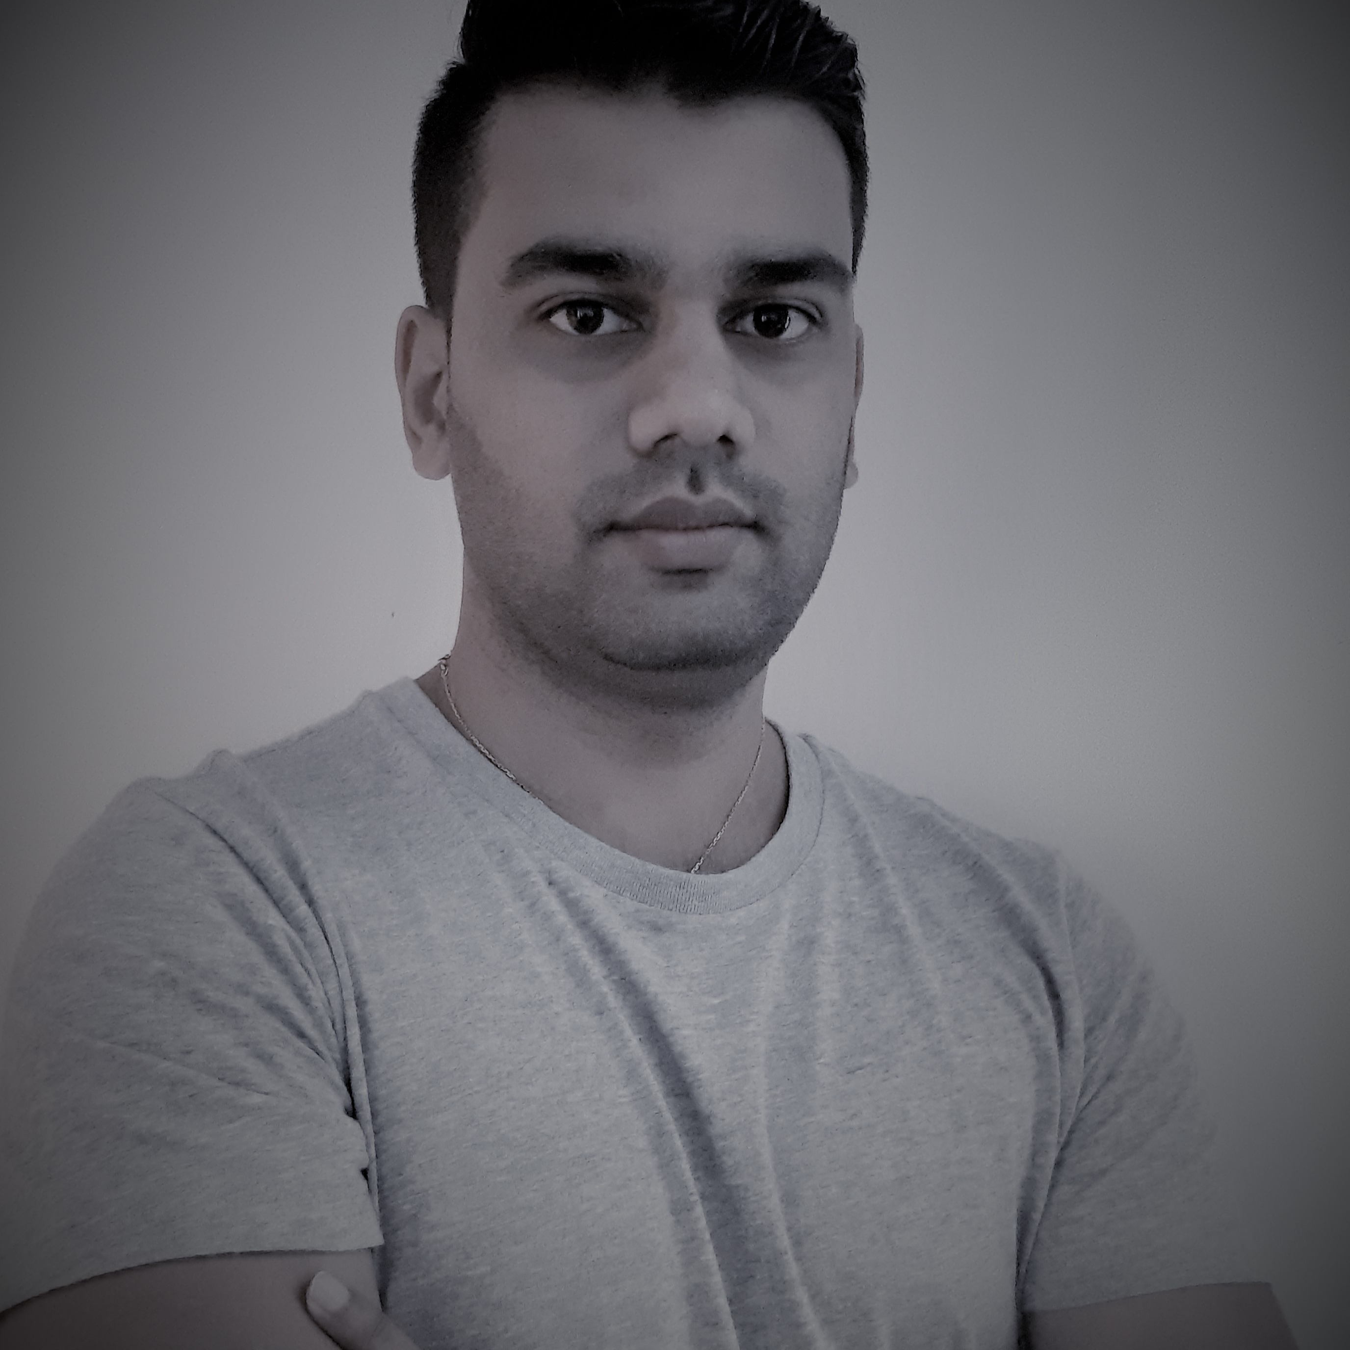

Selected project experience
Areas of expertise
Functional Support Engineer (Feb 2021 – Present)
Ticket solving based on Power BI technology
MSBI Developer/Support
(June 2015 – Feb 2021)
Lead developer. My role was to successfully deliver Microsoft BI projects and post Go-live support
SQL Developer/Support
(May 2015 – June 2015)
Implementing BI solution using Microsoft SQL Server
Functional
ETL Approach
Business Intelligence
Data Warehousing
Data Modelling
Industries
Product and Retail
Transport and Travel
Energy
Technical
Power BI
SQL Server
T-SQL
SSIS
SSAS
SSRS
Visual Studio 2015
Vbscript
Yashashwee MOHABIR
Application Development Senior Analyst
Professional Background
Application Development Senior Analyst with more than 6 years of professional experience in offshore projects.
Acquired knowledge in working on high-impact ERP/BI projects beginning with requirements analysis till post Go-Live Support
Education
BSc(Hons) Computer Science​
University of Mauritius, 2015
Certifications
MCSA: SQL Server 2012/2014

Slide 2

Current Experience
Functional Support Engineer
(Feb 2021 – Present)
Skills & Technologies
Skills
Teamwork
Client facing
Problem Solving
Data modelling
Technical
Power BI
I am responsible for the following project activities:
Problem solving on Power BI Technology
Community Management for Power Platform Services
Cross Team Communication (Onshore/Offshore)
Client interactions
Business Analyst consultant – Worked on SFD document, Process workflow definition in Visio
Onboarding of new joiners to the project

Slide 3
Past Experience
Lead Developer for Transport and Travel Company
(June 2015 – Feb 2021)
Scope definition and Requirements gathering
Sales Technical and Functional consultant
Ensure proper flow of data from client systems to Data warehouse.
Lead team to deployment and ensure post go-live support
SQL Developer / Support for Product and Retail Company
(May 2015 – June 2015)
Data integration using SQL Server management studio
Monitor data integration process and find solutions when there is failure.
Generate reports and send to clients on a weekly basis.
Create and develop new requirements on SSIS and SSMS.
Areas of expertise
Functional
ERP
Business Intelligence
Reporting
Data Warehouse
Integration
Industries
Transport and Travel
Product and Retail
Technical
SQL Server
T-SQL
SSIS
SSAS
SSRS
Visual Studio 2015
Vbscript
Specialized in development of BI systems using SQL Server

